Slide 1
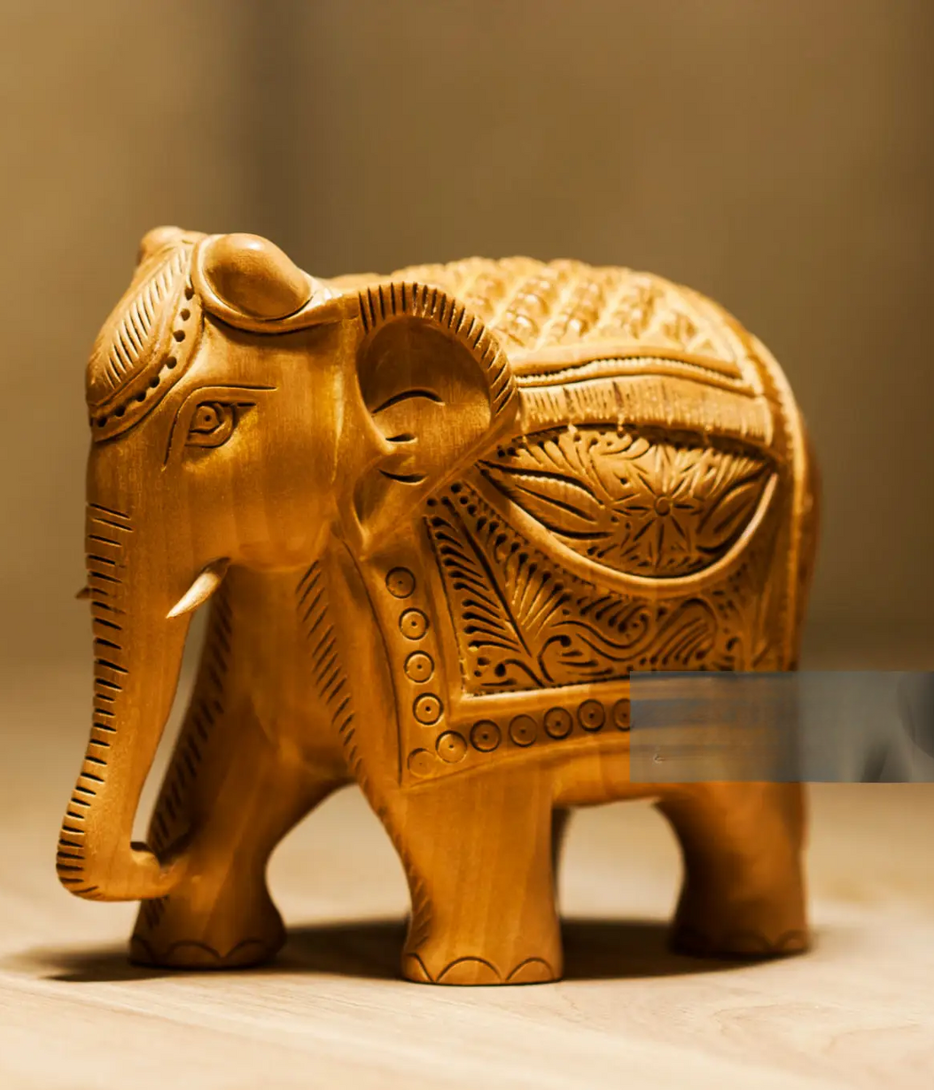
EMPOWERING RURAL ARTISANS FOR SUSTAINABLE DEVELOPMENT USING PR ALGORITHM
Team Members :
Sweatha R (210701275)
Thamizh Bharathi M (210701288)
Thiru Eswaran V (210701290)

Slide 2


Abstract
This project proposes the development of an AI-powered application aimed at promoting traditional products, supporting rural artisans, and safeguarding cultural heritage. This application bridges the gap between skilled artisans and the modern consumer. A key innovation of this platform lies in its elimination of intermediary vendors, thereby enhancing the overall quality of the traditional products and simultaneously offering substantial cost savings to consumers. Furthermore, the application incorporates a Product Recommendation Algorithm, leveraging the power of machine learning. This intelligent algorithm plays a pivotal role in amplifying the sales opportunities for artisans. As users engage with the platform, the algorithm analyzes preferences and behaviors, offering personalized recommendations that cater to individual tastes and preferences. The integration of this technology is poised to revolutionize the way consumers discover and connect with traditional crafts while concurrently providing rural artisans with an expanded market reach.

Slide 3
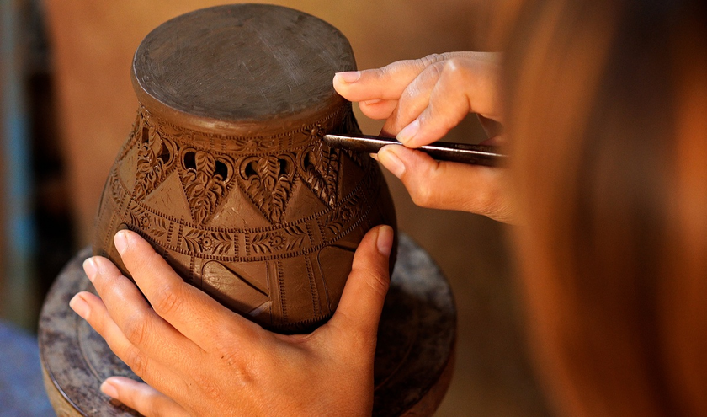

Existing System
Rural artisans were facing challenges in reaching wider markets and promoting their traditional products effectively. Consumers interested in traditional crafts may have limited access to the authentic artisanal products. Existing e-commerce platforms may not specifically cater to the unique needs and preferences of rural artisans, and lack features such as educational content on cultural heritage. Community engagement and support for artisans may be limited. Overall, there is a gap in the market for a dedicated platform that addresses the needs of rural artisans while providing a seamless and engaging shopping experience for users interested in traditional crafts.

Slide 4
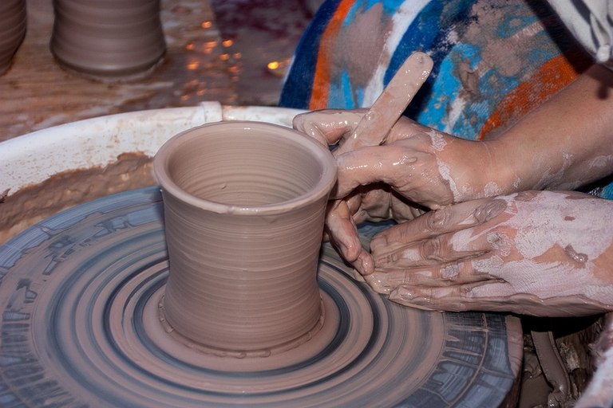
Proposed System
Our system is an online platform connecting rural artisans with consumers interested in traditional crafts. Artisans can register and showcase their products, while users can browse and purchase items securely. The system features a simple and intuitive interface for easy navigation. It includes search and filtering options to help users find specific products. Additionally, a recommendation system suggests personalized products based on user preferences. Educational content enriches the user experience, promoting appreciation for cultural heritage. Continuous updates and user support ensure the system remains efficient and user-friendly.

Slide 5
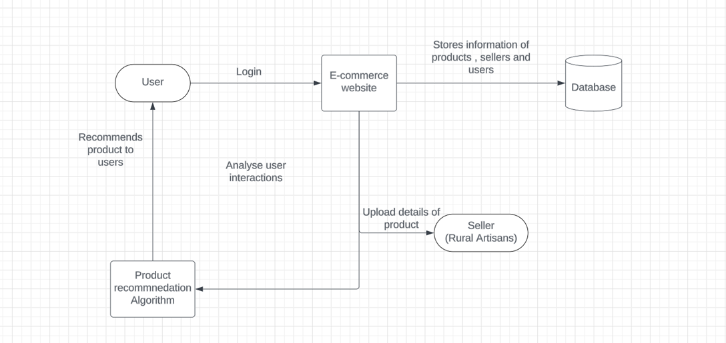
Architecture Diagram

Slide 6

Modules
1. Artisan Registration and Product Listing
User Registration: Allow artisans to register on the website by providing necessary details such as name, contact information, and craft specialization.
Product Listing: Develop a user-friendly interface for artisans to upload product images, descriptions, prices, and other relevant details.
2. User Interface and Experience
User Registration and Profile Creation: Create a seamless registration process for users to create accounts and profiles, allowing them to save preferences and track orders.
Product Search and Navigation: Design an intuitive search and navigation system, enabling users to easily find specific products based on categories, keywords, or artisan profiles.

Slide 7
Modules
3. Recommendation System Implementation
Machine Learning Model Selection: Choose appropriate machine learning algorithms, such as collaborative filtering or content-based filtering, for product recommendation based on user preferences and product similarities.
Model Training and Evaluation: Train the selected machine learning model using the prepared dataset and evaluate its performance based on metrics like accuracy, precision, and recall.
4. Community Engagement and Support:
Artisan Spotlight: Highlight featured artisans and their stories on the website, showcasing their craftsmanship and cultural heritage to create a deeper connection with users.
Continuous Improvement: Gather feedback from users and artisans to identify areas for improvement and implement iterative updates to enhance the website's functionality and user experience.

Slide 8
Result and Discussion
The AI-enabled e-commerce platform project has demonstrated significant strides in promoting traditional products, supporting rural artisans, and preserving cultural heritage.
Leveraging machine learning algorithms, the platform has implemented personalized product recommendations, resulting in notable improvements in user engagement and satisfaction.
By providing a digital marketplace for artisans to showcase their crafts, the platform has empowered artisans with expanded market reach and economic opportunities, fostering economic empowerment in rural communities.
The platform's community engagement features have facilitated meaningful interactions between users and artisans, creating a vibrant online community centered around traditional crafts and cultural heritage.

Slide 9
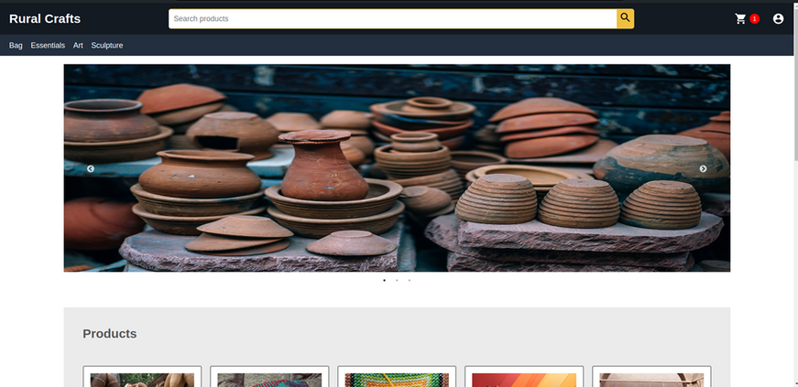
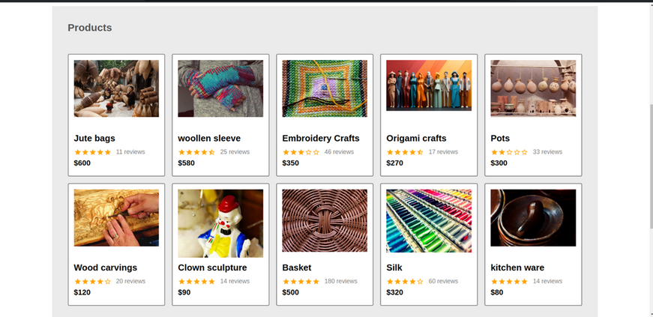
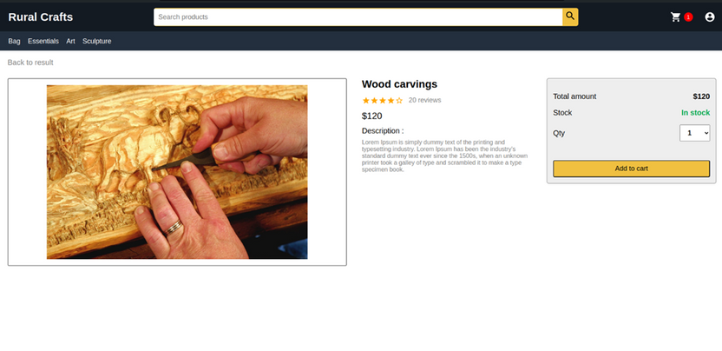
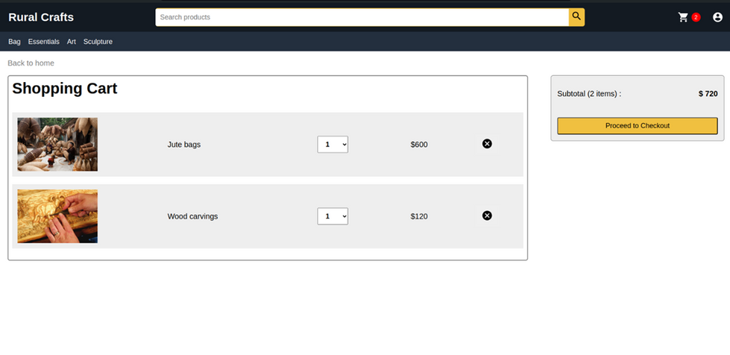
Home screen
Products Page
Checkout Page
Cart Page

Slide 10
Conclusion and Future Enhancements
The development of the AI-enabled e-commerce platform represents a significant milestone in the preservation and promotion of traditional crafts, support for rural artisans, and the conservation of cultural heritage. Through personalized product recommendations, community engagement features, and educational content, the platform has contributed to enhanced user engagement and empowerment of rural artisans. Future work includes implementing more advanced machine learning algorithms for personalized product recommendations, integrating augmented reality (AR) technology for immersive product visualization, exploring blockchain integration for transparent and secure transactions, and offering multilingual support for diverse cultural preferences and global users. These enhancements will further elevate the platform's impact and reach, fostering greater economic empowerment and cultural preservation.

Slide 11
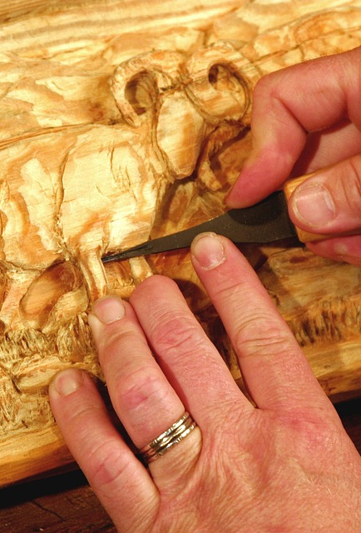
THANK YOU

